Slide 1
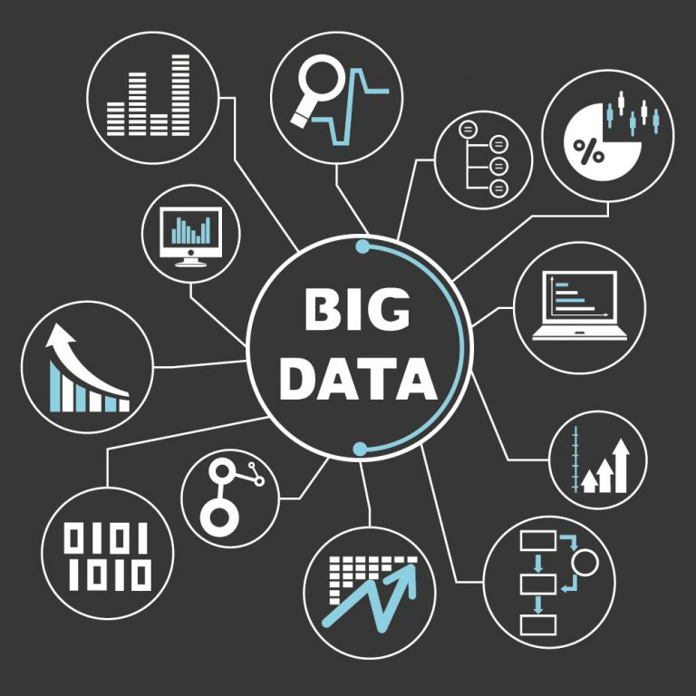
THE RISE OF BIG DATA
Group 9
-3408 Shivprakash Vishwakarma
-3414 Dhruvi Swadia
-3418 Vishal Vishwakarma
-3427 Gaurav Yadav
-3432 Samriddhi Sharma
-3437 Roshan Yadav

Slide 2
INTRODUCTION
“You can’t manage what you don’t measure.”
There’s much wisdom in that saying, which has been attributed to both W. Edwards Deming and Peter Drucker, and it explains why the recent explosion of digital data is so important.
Simply put, because of big data, managers can measure, and hence know, radically more about their businesses, and directly translate that knowledge into improved decision making and performance.
The potential of “big data” has been receiving tremendous attention lately, with interest in the topic growing exponentially, it has been the focus of countless articles and perhaps too many meetings and conferences.
Getting the right data to the right people at the right time is the name of the game in today’s demanding marketplace.
Every company has to find a way to harness big data and use it to drive growth. And if your organization isn’t talking big data, you are at a competitive disadvantage.

Slide 3

WHERE DOES ‘BIG DATA’ COME FROM?
The story of how data became big starts many years before the current buzz around big data. Already seventy years ago we encounter the first attempts to quantify the growth rate in the volume of data or what has popularly been known as the “information explosion”
The term ‘Big Data’ has been in use since the early 1990s. Although it is not exactly known who first used the term, most people credit John R. Mashey for making the term popular.
In its true essence, Big Data is not something that is completely new or only of the last two decades.
However, in the last two decades, the volume and speed with which data is generated has changed – beyond measures of human comprehension.

Slide 4

THE RISE OF BIG DATA
In the third century BC, Historians believed that the library of Alexandria was capable of holding all the data of human knowledge. But today there is such an amount of data available in the world, to give each human 320 times as much of it could be stored in Alexandria’s entire library.
If all this information were placed on CDs and stacked up, it would form many pillars and reach to the moon twice.
The idea of Big Data is simply not new, it is everywhere. It is growing and it is getting tougher and tougher for companies to understand.
The effect of Big Data is everywhere, from business to science, from the government to the arts, where we are, what we like, what we buy and when we buy, with whom we interact and more.

Slide 5

THE HYPE BEHIND BIG DATA
Big data is not just about digitizing existing information. It’s about rendering more of our lives in data in real-time. So the scientists recognized the need to re-think a new approach toward Big Data. Let’s talk about the datafication of the world.
Data Scientists and Analysts need to know about data that can’t be ignored, data that they are not aware of and that can be fully utilized for analysis. In the foreground, it is the extension of human mental capabilities and data understandability.

Slide 6

5 BIG DATA USE CASES- HOW COMPANIES USE BIG DATA
FOR CUSTOMER SENTIMENT ANALYSIS
FOR BEHAVIOURAL ANALYSIS
FOR CUSTOMER SEGMENTATION
FOR PREDICTIVE SUPPORT
FOR FRAUD DETECTION

Slide 7





DRAWBACKS OF BIG DATA
01
02
03
04
DIFFICULT IN USE FOR STRATEGIC DECISION MAKING
BIG DATA DOESN’T PROVIDE A COMPLETE PICTURE
BIG DATA LACKS THE ‘WHY’
PRIVACY AND SECURITY CONCERNS

Slide 8
—THOMAS REDMAN
(President of Data Quality Solutions)
“Where there is data smoke, there is business fire.”

Slide 9


Let’s have a look at different charts that will change your perspective of BIG DATA’S growth

